Slide 1
COMP 1537
Asynchronous JavaScript and XML (AJAX)

Slide 2
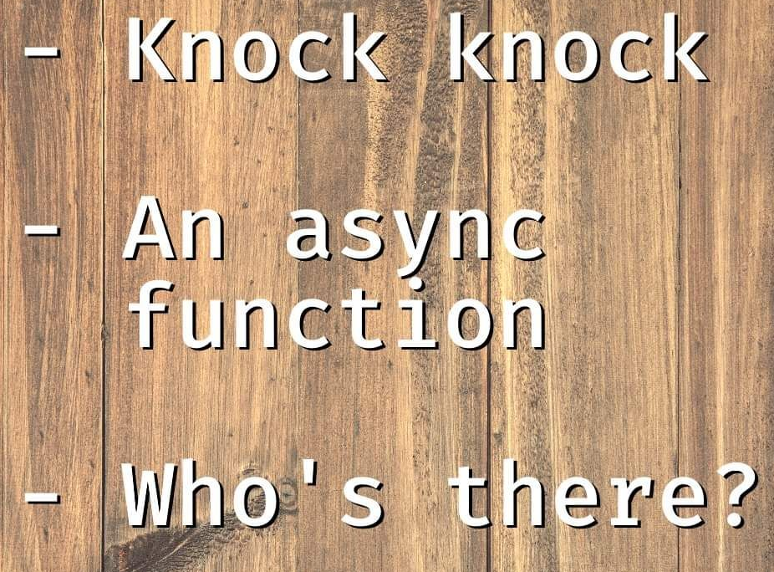
Intro to Ajax
Asynchronous JavaScript And XML (AJAX)
Asynchronous – the JavaScript code makes a call and returns immediately (remember callbacks?)
Rather than wait for a response
JavaScript – the programming language on the client side interacting with a server (e.g., PHP, or JavaScript again if you’re using Node.js)
XML – a syntax for structured data (e.g., HTML)
Note: the data does not have to be XML – it can be anything that is text (usually JSON)
And even binary data such as images!
Uses the following technologies:
JavaScript, HTML, CSS (which is optional), and server-side code (e.g., JavaScript with Node.js)

Slide 3
Why AJAX?
Reloading an entire page is expensive in:
Bandwidth (if your users are on cell phone data plans, this can cost them $$$)
User time – waiting for the entire page to reload
Developer time – making an entirely new page (or pages)!
All modern web apps use this
Example: typical social media web app, where only a section is updated
Update: an advertisement, notifications, image gallery, newsfeed, friend requests
Only a section of the page is updated
This is faster, doesn’t require as much bandwidth, and mimics traditional desktop/mobile apps

Slide 4
The XML vs. JSON Debate (1/3)
AJAX was originally meant to send/receive XML (the syntax used for HTML)
Over time, JSON is preferred – unless you are doing large web services at Amazon
How they are similar:
Both are standards used for the web
Both have extensive API coverage in most web languages/platforms
Both are text based (Unicode)
Both used to transport data to/from client/server
And be used as a data exchange
Neither are well-suited to binary exchange (e.g., images)
Although can text-encode binary using BinHex or Base64

Slide 5
The XML vs. JSON Debate (2/3)
How they differ:
They have a different syntax
XML is more verbose, JSON is a subset of JavaScript
XML is extensible (i.e., new element names, namespaces)
JSON cannot
JSON uses key/value pairs
XML uses begin/end tags, attributes
XML can be both document-centric or data-centric
JSON is best as data-centric
XML can be validated against a rule-set (i.e., constraints)
E.g., only allow integers, not text

Slide 6
The XML vs. JSON Debate (3/3)
Which one to use and when?
Use XML for:
Highly structured data
When validation is required
When the data payload is renderable content (e.g., HTML)
Don't forget, HTML is XML if the HTML is well-formed!
Don't want to have to reconstruct the view content all over again on the client
Use JSON for:
When you are sending lots of data-centric content
When the rendering of the data may not be known
Or reconstructed in different ways/facets (e.g., a table, a list)
You need short bursts of data

Slide 7
How to AJAX – the server (1/3)

Slide 8
How to AJAX – the server (2/3)
Analysis of the code:
Doesn’t look any different than a regular call – this is true, it doesn’t!
Line 2: the request object has an object property called ‘query’
Remember, objects in JS are associative arrays (Python programmers know this as a dictionary)
We can gain access to any query parameters that are passed to us from the client
E.g., the following URL: http://localhost:8000/weekdays?format=html
Would mean that req.query[“format”] == “html” // true
Lines 44, 49 set the content type of the response header to certain MIME types
Based on what we are sending back to the browser
There are many, many MIME types available!
You don’t have to know them all, but there are some that are good to know!

Slide 9
How to AJAX – the server (3/3)
Lines 45, 50, and 54:
All send something – depending on the condition of the query parameter
Line 54 just sends an error message in JSON format
This is what we would call an application protocol
It sits on top of the HTPP protocol and is specific to our domain/app
We’ve decided that if you don’t give either ‘html’ or ‘json’ to the ‘format’ query parameter
You get an error message in the form of JSON format with a status key-pair, and a msg key-value pair
Notice line 1 has a callback function?
Again, much, even most of JS you do will be based on callbacks and thus, utilizing the asynchronous nature of JS

Slide 10
How to AJAX – the Client (1/6)

Slide 11
How to AJAX – the Client (2/6)
Analysis of the code:
This is the code for performing any call to the server – refactored so that we don’t keep typing the same code every time – we’ll call this function, ‘ajaxGET’
Line 1: two arguments – the URL to connect to, and the callback function to invoke
Line 2: instantiate an XMLHttpRequest object (this connects to the server for us)
Line 3: The XMLHttpRequest has an onload function – we are overriding it’s default behavior
This will invoke the callback function:
When we get HTTP 200 (OK) and the request is completed (DONE)
Otherwise, we’ll print the status to the console (meaning something went wrong)
Line 6: ‘this.responseText’ from the server: res.send(), lines 8, 12, 15
Line 11: XMLHttpRequest is opened to the server
Line 12: XMLHttpRequest sends data to the server

Slide 12
How to AJAX – the Client (3/6)
Before we show our client-side code calling up the ‘ajaxGET’ function, let’s refer back to slide two’s image meme and ask ourselves this:
What is the order of execution of the code in the ‘ajaxGET’
Is it:
Lines: 2, 3, 11, 12
Lines 2, 11, 12, 3
What is the correct answer? Why?

Slide 13
How to AJAX – the Client (4/6)
Analysis of the code:
Line 1: DOM selects element, adds an event listener (on the ‘click’ event)
Also line 1: The event callback function accepts an event object ‘e’ as the argument
Line 3: we call the ‘ajaxGET’ function & pass it the URL on the server
And a callback function … so this is now a callback function within a callback function!
Also line 3: ‘data’ is passed in from ‘ajaxGET’, line 6 (slide 10)
Line 6: since the server sent HTML, we can simply update the DOM
HTML is easy on the client side, but what about if the server sends JSON?

Slide 14
How to AJAX – the Client (5/6)

Slide 15
How to AJAX – the Client (6/6)
Analysis of the code:
Same as before, except here we are asking for JSON (line 3 query parameter)
Line 6: we need to parse the text from the server side and turn it into JSON in the browser’s JS runtime (before this, it’s just text, not objects)
Lines 8 – 12: we need to go through all of the properties that make up the JSON object hierarchy and turn them into HTML for our document
Line 13: takes the concatenated string and adds it to the document

Slide 16
A Few Observations
JSON is easier to send on the server side – but involves more work on the client to turn into HTML
HTML can be more involved to create/generate on the server-side – unless it’s already a static document
But very easy on the client side – just drop it in!
Why would you want to do both?
If your server can send both types of data, your server can answer calls from:
Web browsers
Native mobile apps
Callbacks in JS are integral to software development in web!
Avoid callback hell (i.e., more than three levels in)

Slide 17
Resources (1/1)
The example code in the slides is part of the ‘node-ajax’ example for COMP 1537
https://developer.mozilla.org/en-US/docs/Web/API/XMLHttpRequest
https://javascript.info/xmlhttprequest

